Slide 1
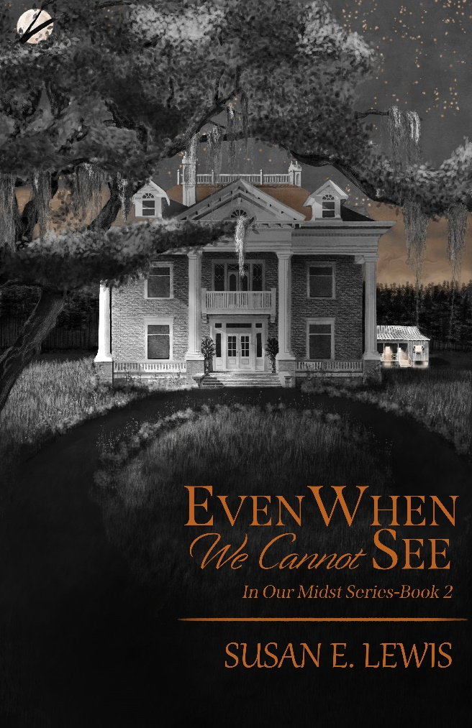
For High School English Classes
“If we can learn to look at ourselves and at life through God’s eyes—His perspective, His viewpoint—we will be changed. And we will gain the peace, strength, and wisdom to journey through the storms of life.” --Susan E. Lewis
A Curriculum Unit of Study to accompany the novel Even When We Cannot See
by Susan E. Lewis
Challenging youth to pursue truth and see life through God’s perspective.
Notes:
NOTE:
To change the image on this slide, select the picture and delete it. Then click the Pictures icon in the placeholder to insert your own image.

Slide 2

Even When We Cannot See: The Curriculum Packet
The Curriculum Packet associated with the book is full of important discussion points, fun and informational activities, charts, and deep-thinking questions to enhance the book’s three themes.
Challenging youth to base their beliefs on what is true.
Notes:
NOTE:
To change the image on this slide, select the picture and delete it. Then click the Pictures icon in the placeholder to insert your own image.

Slide 3
Even When We Cannot See: The Curriculum Packet
Vital truths presented throughout this packet for study, contemplation, and application--
It is possible to transcend or move above a certain perspective with training and enlightenment. This shows the importance of who we listen to, who we train under.
Watch your life and doctrine closely (your perspective and absolutes). Persevere in them, because if you do, you will save both yourself and your hearers. 1 Tim. 4:16
Look at a person’s actions, not just their words. Fruit refers to what a person produces in his/her life. Not what he says he produces.
.
If students can truly believe in the goodness of God, they will have powerful truths to help them when adversity enters their lives.
Weighty matters will keep a smart man silent while he’s trying to figure it all out.
Deception is all around us. But we cannot always see it. Not everything is as it seems.
Challenging youth to base their beliefs on what is true.
Notes:
NOTE:
To change the image on this slide, select the picture and delete it. Then click the Pictures icon in the placeholder to insert your own image.

Slide 4
Even When We Cannot See: The Curriculum Packet
Some of the many Discussion Points--
How does perspective influence attitude?
Some absolutes are indisputable; others are opinion. Why is that important?
How do we know God is trustworthy?
How do we know who to trust?
Challenging youth to base their beliefs on what is true.
Notes:
NOTE:
To change the image on this slide, select the picture and delete it. Then click the Pictures icon in the placeholder to insert your own image.

Slide 5
Even When We Cannot See: The Curriculum Packet
charts-
Different perspectives
Looking at the reliability of Jesus
Seeing through God’s eyes
Bible verses teach life’s viewpoints
Challenging youth to trust God even in adversity.
Notes:
NOTE:
To change the image on this slide, select the picture and delete it. Then click the Pictures icon in the placeholder to insert your own image.

Slide 6
Even When We Cannot See: The Curriculum Packet
Fun and Meaningful Activities-
Framing your perspective – an art activity
Who is telling the truth? – A What-if activity
Getting creative – honoring a follower of Christ
Become an investigator
Challenging youth to pursue truth and see life through God’s perspective.
Notes:
NOTE:
To change the image on this slide, select the picture and delete it. Then click the Pictures icon in the placeholder to insert your own image.

Slide 7
Even When We Cannot See: The Curriculum Packet
Writing Assignments
Creating a descriptive narrative or poem with strong imagery
Connecting to perspectives-- writing about the lockdown of the 2019-2020 school year
Writing a nomination speech
Challenging youth to pursue truth and see life through God’s perspective.
Notes:
NOTE:
To change the image on this slide, select the picture and delete it. Then click the Pictures icon in the placeholder to insert your own image.

Slide 8
Even When We Cannot See: The Curriculum Packet
Themes—The heart of the story
We can trust God because of His character and His abilities.
We must discern between good and evil, truth and lies.
Our perspective of life and the absolutes we have will determine our choices, attitudes, and responses.
Challenging youth to trust God, even in adversity.
Notes:
NOTE:
To change the image on this slide, select the picture and delete it. Then click the Pictures icon in the placeholder to insert your own image.

Slide 9

Relevant Bible Verses
Matthew 7:15, 16a, 18 Watch out for false prophets. They come to you in sheep’s clothing, but inwardly they are ferocious wolves. By their fruit, you will recognize them. A good tree cannot bear bad fruit, and a bad tree cannot bear good fruit
John 15:5 (Jesus said) I am the vine; you are the branches. Whoever abides in me and I in him, he it is that bears much fruit, for apart from me you can do nothing.
Isaiah 41:10 Fear not, for I am with you; be not dismayed, for I am your God; I will strengthen you, I will help you, I will uphold you with my righteous right hand.
Deuteronomy 30:19 This day I call the heavens and the earth as witnesses against you that I have set before you life and death, blessings and curses. Now choose life so that you and your children may live. (perspective of trusting God)
1 Timothy 4:12 and 16 Don’t let anyone look down on you because you are young, but set an example for the believers in speech, in conduct, in love, in faith, and in purity. Watch your life and doctrine closely (your perspective and absolutes). Persevere in them, because if you do, you will save both yourself and your hearers.
The Bible: Our Reliable Resource
Photo courtesy of unsplash.com
More verses are in the packet.

Slide 10
Literary Techniques
Alliteration—a writing technique using repeated initial consonant sounds in a phrase
Metaphors and Similes—a phrase showing a comparison of two unlike objects. Similes have like or as; metaphors do not.
Motifs—images, ideas, sounds, or words that help to explain the theme or central idea of a literary work; is a recurring element
Imagery—vivid, strong, expressive word choices or figurative language that builds a mental image for the reader
Challenging youth to set godly perspectives and absolutes
Notes:
NOTE:
To change the image on this slide, select the picture and delete it. Then click the Pictures icon in the placeholder to insert your own image.

Slide 11

METAPHORS AND SIMILES
A FEW EXAMPLES FROM THE NOVEL:
. . . tall slender reeds bending in the wind, their tasseled tops waving like little flags.
Her tone was a brick wall.
“They (fabrics) are like exotic paints I can wrap around my fingers.”

Slide 12
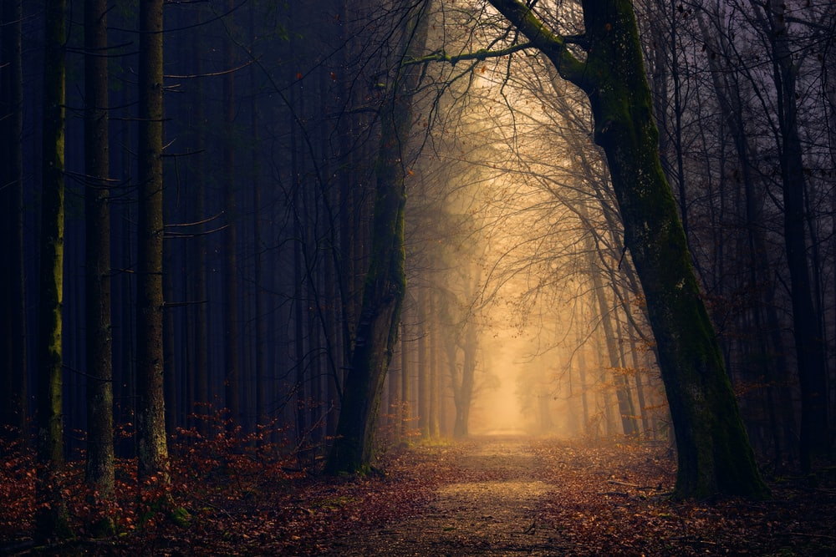
MOTIF
THE MAJOR MOTIF IN THE NOVEL IS:
Light vs. Dark
As seen in references to shadows, light, and darkness
Example: The air felt heavy, oppressive, growing more so as we sat there in the deepening shadows of the approaching night.
I hoped and prayed that the dark conversation going on behind the far door would make a difference.

Slide 13

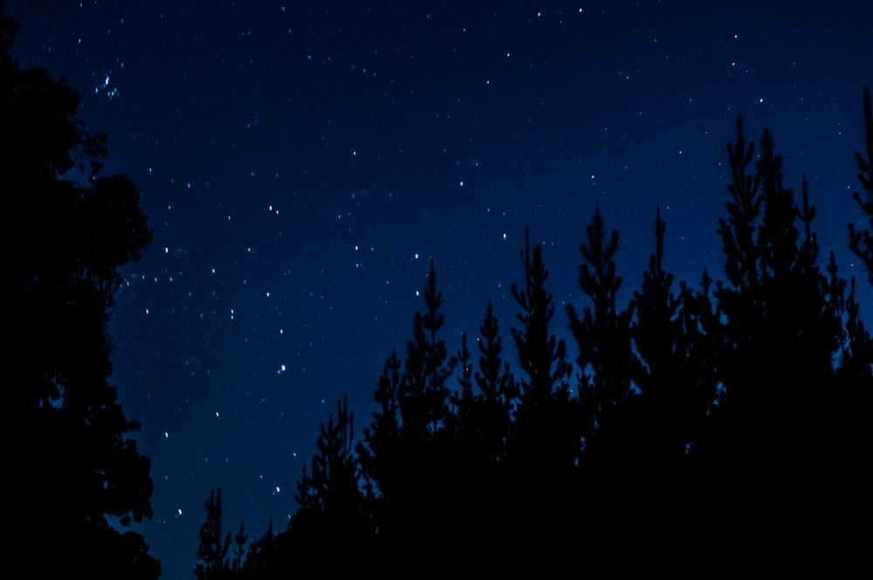
IMAGERY
Examples from the story
I walked to the edge of the water, where tiny shells burrowed back into the wet sand as foam with salty bubbles popped and formed a curved line to remind us where the water had been.
The forest ended and a quiet field moved with us. I could see the stars against the open night sky sparkle and glitter, steady against the darkness.

Slide 14
For Display in the classroom
Truths from the book and the curriculum

Slide 15
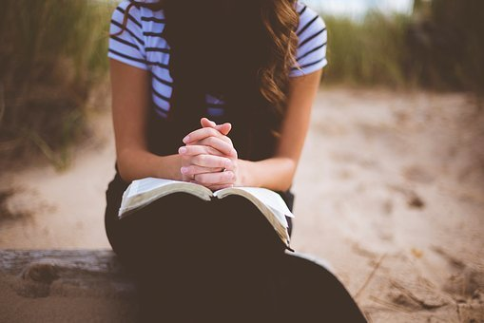
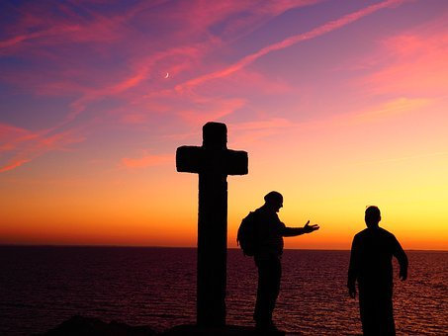
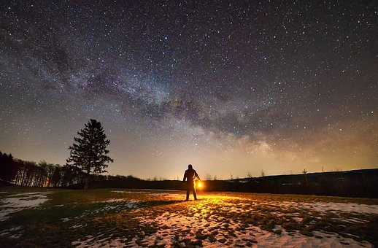
We must learn to discern between good and evil, truth and lies, because deception is all around us.
Learning from the characters—
Marc and Maylee determine the truth by
· Praying
· Consulting with people they trust
· Thinking about and being open to the evidence around them

Slide 16


Our perspective of life and the absolutes we have will determine our choices, attitudes, and responses—even during adversity.
A person who believes in absolutes frames his decisions by truths that do not change and are set by a morally upright deity who also does not change and has the best interest for humankind in mind at all times.
We all have to choose.
As Deuteronomy 30:19 says: “This day I call the heavens and the earth as witnesses against you that I have set before you life and death, blessings and curses. Now CHOOSE LIFE so that you and your children may live.”
Choose a
Life of Integrity and Goodness

Slide 17

God is worthy of our trust because of his character and his abilities.
We can stand on these truths about God’s character.
God loves us and wants the best for us. | God is sovereign and is in control of everything. | God keeps His promises.

Slide 18
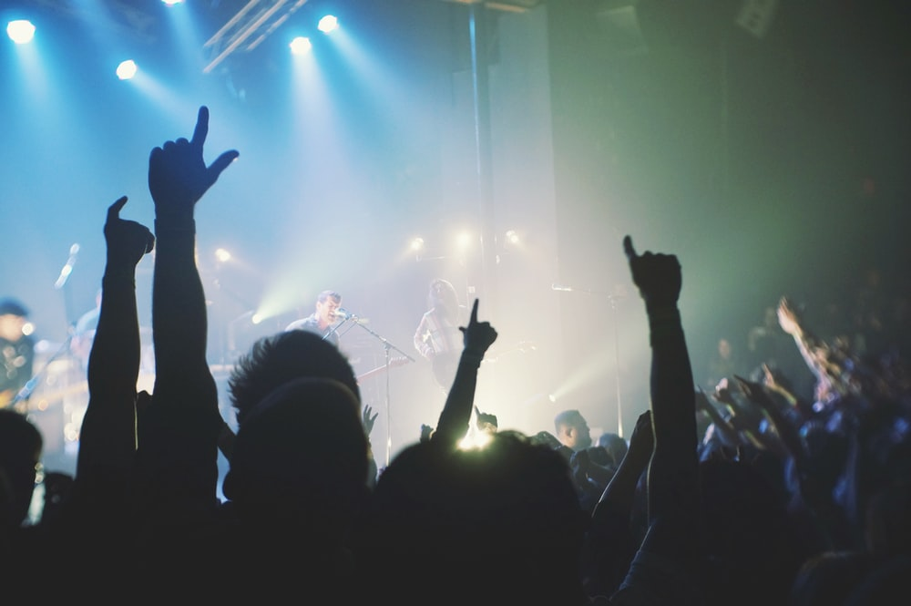
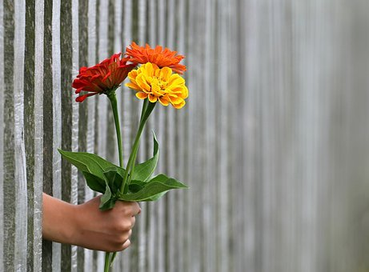
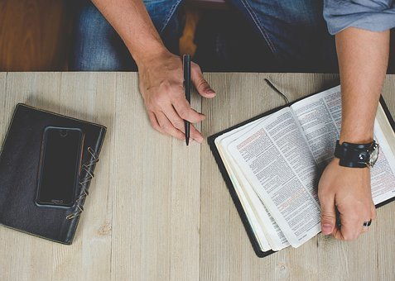
Who can we trust to tell us the truth?
The answer: Look for RELIABLE SOURCES—
Evaluate the testimony of others
Refer to the Bible, the Word of God
Look at the fruit of the people who are trying to influence you.

Slide 19

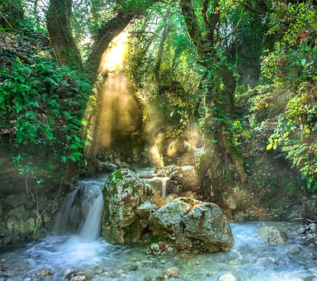
WE CAN TRUST GOD!
Revelation 21:6 He said to me, “It is done. I am the Alpha and the Omega, the Beginning and the End. To the thirsty I will give water without cost from the spring of the water of life.”
Faith in God includes faith in His timing.
No matter what happens—TRUST GOD!

Slide 20
THE GREATEST PERSPECTIVE OF LIFE--TRUSTING GOD!
If we can learn to look at ourselves and at life through God’s eyes—His perspective, His viewpoint—we will be changed. And we will gain the peace, strength, and wisdom to journey through the storms of life.
Looking at ourselves through God’s eyes | Looking at life through God’s eyes | Looking at trials through God’s eyes
Zephaniah 3:17 The Lord your God is with you, the Mighty Warrior who saves. He will take great delight in you; in his love he will no longer rebuke you, but will rejoice over you with singing. | Jeremiah 29:11 For I know the plans I have for you, declares the Lord, plans to prosper you and not to harm you, plans to give you hope and a future. | Joshua 1:9 Have I not commanded you? Be strong and courageous. Do not be frightened, and do not be dismayed, for the Lord your God is with you wherever you go.
Psalm 139:13-14 For you created my inmost being; you knit me together in my mother’s womb. I praise you because I am fearfully and wonderfully made; your works are wonderful, I know that full well. | John 3:16 For God so loved the world, that he gave his only Son, that whoever believes in him should not perish but have eternal life. | Romans 8:28 And we know that for those who love God all things work together for good, for those who are called according to his purpose.

Slide 21

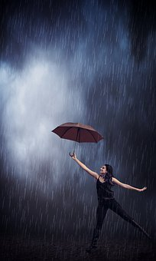
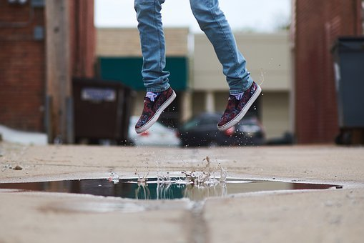
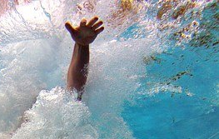
Symbols of God’s Promises
James 1:17 “Every good and perfect gift is from above, coming down from the Father of the heavenly lights, who does not change like shifting shadows.”
Gentle and
Humble
God always keeps His promises!
Matthew 11:28-30 “Come to me, all you who are weary and burdened, and I will give you rest. Take my yoke upon you and learn from me, for I am gentle and humble in heart, and you will find rest for your souls. For my yoke is easy and my burden is light.”

Slide 22

Teens--Be Encouraged!
Find your purpose,
Stand for what is right, and
Use your gifts and talents
to make this world a better place.
1 Timothy 4:12 and 16
Don’t let anyone look down on you because you are young, but set an example for the believers in speech, in conduct, in love, in faith, and in purity. Watch your life and doctrine closely (your perspective and absolutes). Persevere in them, because if you do, you will save both yourself and your hearers. (You will find and live God’s plan and purpose for your life.)

Slide 23
Thank you for your support
And for believing in the mission of building stronger young adults
Susan E. Lewis, author of Even When We Cannot See

