Slide 1
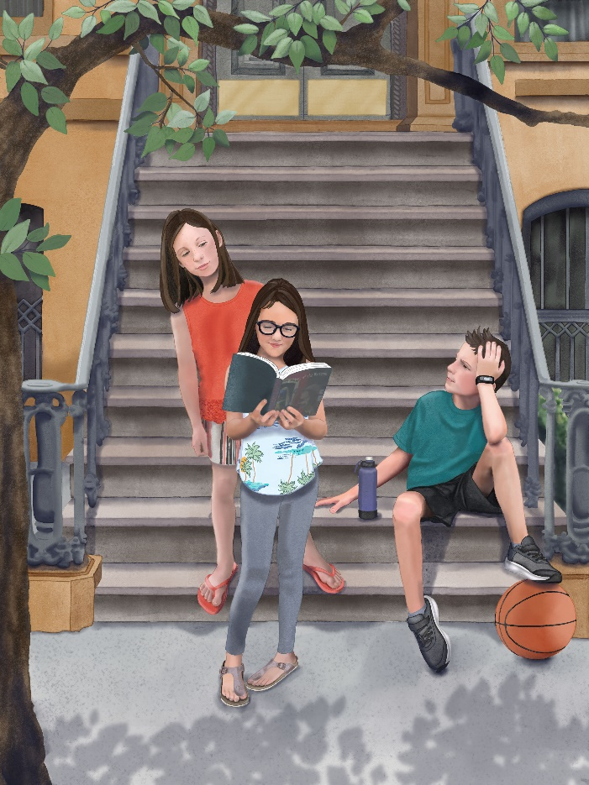
THE Three SLEUTHS
OF BROOKLYN by Susan E. Lewis
For Middle Grades (4th or 5th grade)
A Curriculum Packet of Activities
Published by Casting Light Publishing Company
Notes:
NOTE:
To change the image on this slide, select the picture and delete it. Then click the Pictures icon in the placeholder to insert your own image.

Slide 2
Basics About the Book
Characters | Settings | Type of Story | Themes
Abrielle Martin | Brooklyn, NY | Middle Grade | Not everything is as it seems
Best friend Gina | Hollander Bakery | Adventure | Sometimes we have to think outside the box
Leon DeLuca | Metropolitan Museum of Art | Mystery
Mrs. Metzger | Filettos (an Italian restaurant)
Mama (Jackie Martin) | Ellis Island
Mr. Russo
Peter Metzger

Slide 3
PRE-READING ACTIVITIES
Abrielle
Gina
Leon
Objectives: To make predictions based on limited information about the story; to improve comprehension while reading the story
. . . . . . . . . . . . . . . . . . . The Three Sleuths of Brooklyn

Slide 4
Pre-Reading Activities
1.
Know/Don’t Know Chart
2.
Vocabulary
3.
Predict with “fill-in-the-blanks”
More information about each activity follows

Slide 5
Pre-Reading Activity #1 - Know/Don’t Know Chart
Using the following words and phrases to introduce the story, students help the teacher fill in the chart with what they already know and what they don’t know about each.
 | What we know | What we don’t know
Brooklyn, NY
Brownstone row houses
Bakeries
Husky dogs
Ellis Island
Metropolitan Museum of Art
Being evicted

Slide 6
Pre-Reading Activity #2: Making Predictions
Based on the following phrases taken from the story The Three Sleuths of Brooklyn, what do you think is going to happen? How might these things be related?
Paint splotches
Neighbor-hood Mystery
Eviction Notices
Home Alone
Book collage
Italian restaurant
Museum for inspiration
Brooklyn row houses

Slide 7
Pre-Reading Activity #3: Fill-in-the-Blank
The following sentences come from the story The Three Sleuths of Brooklyn. Have students guess what word is missing prior to reading the story. After reading the book, you can go back and have students see if their guesses were correct or even close.
The shutter’s squeaky ______________ sent Gina and me scurrying.
Our favorite _______________ had mysteriously closed several months ago.
“And I get tired of eating ________________________________________________.”
“You mean my books might __________________ you?” Mrs. Metzger asked.
The canvas was covered in ____________ of paint.
Well, that is interesting. Gina has come away with a new love of art and you, a new love of _________________.
Gina and I arrived at Mrs. Metzger’s house early, prepared to spend the whole day finishing our unusual ___________________.
The woman who sat behind me furiously searched through her ________________.
“I found out that everyone on the block got an _______________ notice from Peter Metzger.”
The sudden movement of a _____________________ caught our attention.
He dropped a heavy bag of _______________ onto the floor above us.
“Help, we’re _______________ ___,” Leon shouted.

Slide 8
vocabulary ACTIVITIES
Abrielle
Gina
Leon
Objectives: Students will be able to read, explain the definition, and use the following vocabulary (from the story) in sentences and discussion.
. . . . . . . . . . . . . . . . . . . The Three Sleuths of Brooklyn

Slide 9
Vocabulary from the Story
The vocabulary words for study are listed below as well as in the Curriculum Packet. Further information about each word, including definitions, sentence usage, parts of speech, and activity ideas can be found in Appendix 1 of the Curriculum Packet.
Sleuths 14. Envisioned
Grimacing 15. Ancestors
Scurrying 16. Immigration
Jittery 17. Ricocheted
Mysteriously 18. Whirligigs
Baffling 19. Eviction
Monotony 20. Proprietors
Radiator 21. Adamant
Scrumptious 22. Condominium
Stoop 23. Collage
Splotches 24. Tribute
Vibrant 25. Illuminating
Magnificent

Slide 10
Vocabulary Activities
1.
Connect words to sentences
2.
Picture collages
3.
Cartoon Dialogue
4
See Appendix 1 in the Curriculum Packet for more information about each activity.

Slide 11
Discussion questions
Abrielle
Gina
Leon
Objective: To quote accurately from the text when explaining what the story says and when drawing inferences from the text.
. . . . . . . . . . . . . . . . . . . The Three Sleuths of Brooklyn

Slide 12
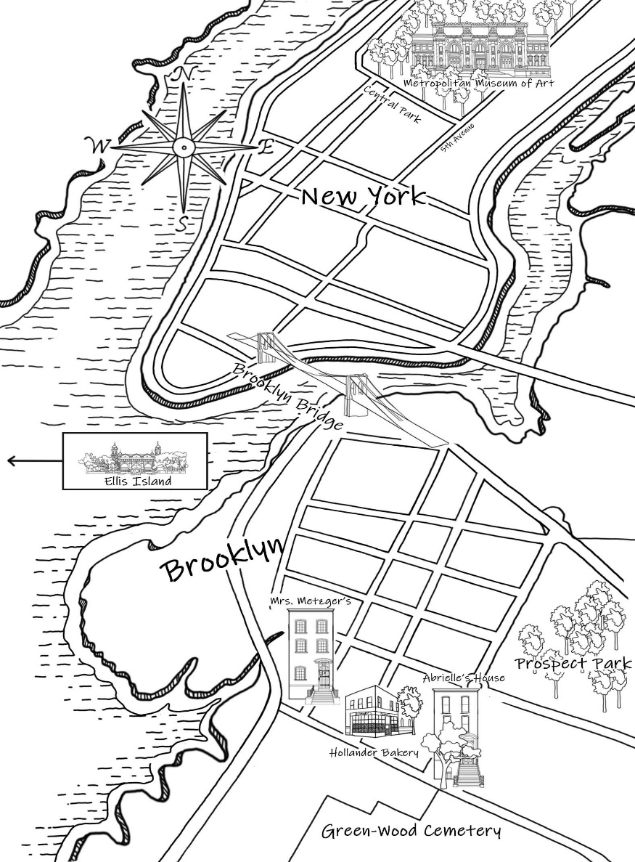
Discussion Questions
See the Curriculum Packet for comprehension questions. These questions are designed to encourage the students to quote literal facts from the story (such as where the story takes place) as well as make interpretations, conclusions, and opinions based on the characters and events.

Slide 13
Connecting to other subjects
Abrielle
Gina
Leon
Objective: To transfer new knowledge gained from the story and its themes.
. . . . . . . . . . . . . . . . . . . The Three Sleuths of Brooklyn

Slide 14
Connecting to Science (Answers in Packet)
The meaning of colors:
Move each box to match the meaning to its color.
Peaceful, loyal, has integrity
Imaginative, creative, wise, grand
Growing in knowledge
Optimistic and cheerful
Energetic and full of action

Slide 15
Connecting to Science
Just an introduction to the science of color. I’ll leave it to the wonderfully clever science teachers to develop fun activities to go with the Free School YouTube video - The Science of Light and Color for Kids: Rainbows and the Electromagnetic Spectrum.
https://www.bing.com/videos/search?q=The+Science+of+Light+and+Color+for+Kids%3a+Rainbows+and+the+Electromagnetic+Spectrum.+&view=detail&mid=620EB147F95B23D053A4620EB147F95B23D053A4&FORM=VIRE
Source:
Free School. “The Science of Light and Color for Kids: Rainbows and the Spectrum,” April 6, 2017, YouTube video, 4:38, https://patreon.com/freeschool.

Slide 16
Connecting to Math
Teach the students the difference between a bar/column and a line graph.
Instructions to the students: Find out the favorite colors of your friends and family. Take a survey of 50 people, asking what their favorite color is. Keep the tally count in a notebook. Stay organized. When the survey is complete, create a graph (teacher’s choice or your choice) to show the results of the survey.
Examples of line and bar/column graphs

Slide 17
Problem Solving:
Learning to think outside the box
See Curriculum Packet, Appendix 5, Activity 2
Possible Tasks
Retrieve coin fallen in drain
Remove pebbles from dirt
Move heavy rock
Open a metal box rusted shut
Use as a signal for help when lost in the woods
Create a new game
Lost in woods and need to catch a fish for dinner
Solving a task with only a few tools

Slide 18
Research and writing —connecting to history
Abrielle
Gina
Leon
Objective: To transfer new knowledge gained from the story and its themes.
. . . . . . . . . . . . . . . . . . . The Three Sleuths of Brooklyn

Slide 19
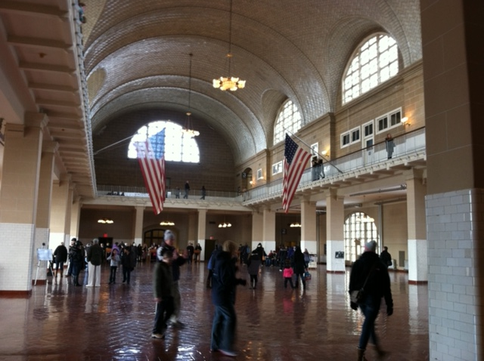
Researching and Writing: Connecting to History
Students will listen to and read information on Ellis Island, the landing place for many European immigrants like Abrielle’s relatives from France. Her friend Leon’s family immigrated from Italy, and Mrs. Metzger and her husband immigrated from Germany. After reading information about the island, students will have two fun writing activities to participate in. Teachers can choose one or do both as enrichment activities to accompany The Three Sleuths of Brooklyn.
Main Hall at Ellis Island
(the Processing Room)

Slide 20
Research and Writing -- Immigration and Ellis Island
Read
Letter written by immigrant
Newspaper article about Ellis Island
Directions when arriving at Ellis Island
Watch
Video about immigration and Ellis Island
Write
An immigrant’s journal after arriving in US
Dialogue for conversation
Participate and Pretend
Being an immigrant from 1906
Interviewing an immigrant from 1906
More details are available in the Curriculum Packet

Slide 21

Researching and Writing: Connecting to History
Read
a letter from a young immigrant and a news article from the 1900s (see Curriculum Packet)
this video from YouTube about Ellis Island
Watch
Photo courtesy of unsplash.com
https://www.youtube.com/watch?v=VPzNA9JsoXg
Source:
Frederick, Brianna and Ashley Colwell, “Ellis Island,” February 26, 2013, YouTube video, 3:29, https://www.youtube.com/watch?v=VPzNAgJsoXg.
See Appendix 9 in the Curriculum Packet for a note taking worksheet that gives the students an opportunity to listen for answers to questions about this video. The next slide has the questions, as well. Teachers, you can use this slide to review the questions before the video and to check the answers together afterward. The video is short enough to go back through and replay parts to reveal any answers students missed.

Slide 22
Researching and Writing: Taking Notes
Watch Video
Title of video __________________________________________
Who is this video about? ____________________________________________
Where are the people going? ________________________________________
Why? What do they want? ______________________________________________________________________
What were some hardships they faced? Name at least two. ____________________________________________________________________________________________________________________________________________
Did everyone get to stay? _______ Why or why not? ____________________________________________________________________
What happened to Ellis Island that closed it for two years? ____________________
Write two sentences telling what you learned from the video.
Take Notes

Slide 23
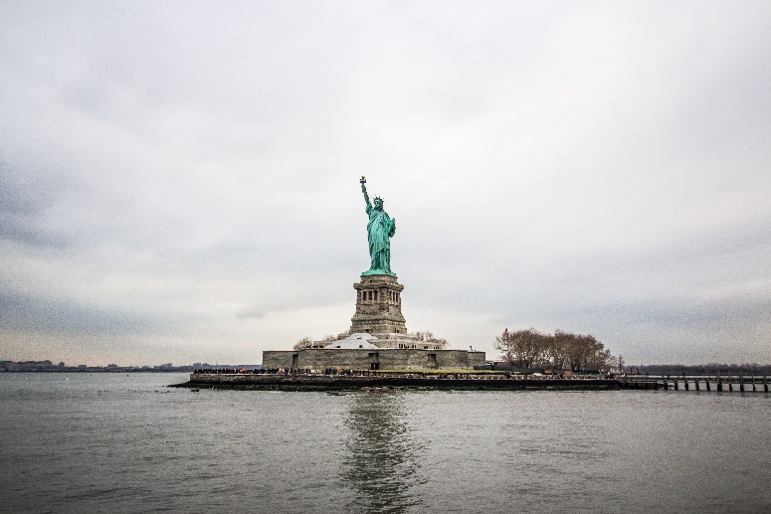

Researching and Writing: Connecting to History
After watching the video about Ellis Island, the students can participate in two fun writing exercises:
(1) Have students write a pretend letter to a family member or friend back home about their arrival in America (using information from the video and from a class discussion). Can be used for an English composition grade or for enrichment.
(2) Based on the video, the letter written by an immigrant, and the news article from 1906, students create questions and answers for a pretend interview. (more details in packet)
Use the next slide to teach quotation and dialogue writing rules.
Write
Participateand Pretend
Photos courtesy of unsplash.com

Slide 24


How to Write: Quotations and Dialogue
>>Quotation marks – two marks placed in front and after the exact words (called a quote or quotation) that someone says.
Example: “I see the Statue of Liberty,” Lucy exclaimed.
>>Quotation tag – the phrase that tells who is talking. The quote tag can be before or after the quote.
Example: Papa said, “They should let us off the boat soon.”
>>Punctuation – What punctuation separates the quotation tag from the quote? _______________
(Note: sometimes a question mark will be used.)
>>Always, always punctuation rule – the punctuation mark that ENDS the quote is always inside the quotation marks.
Another example: “I’ll be so glad to get off this boat,” Lindy said with a smile on her face.
Write
Activity idea: Have students come up and identify by circling the quotation marks and/or quotation tags in the examples.
Optional: A worksheet to practice working with quotations and dialogue can be found in Appendix #10 of the Curriculum Packet.

Slide 25
Fun Extras: Photos
Abrielle
Gina
Leon
. . . . . . . . . . . . . . . . . . . The Three Sleuths of Brooklyn

Slide 26
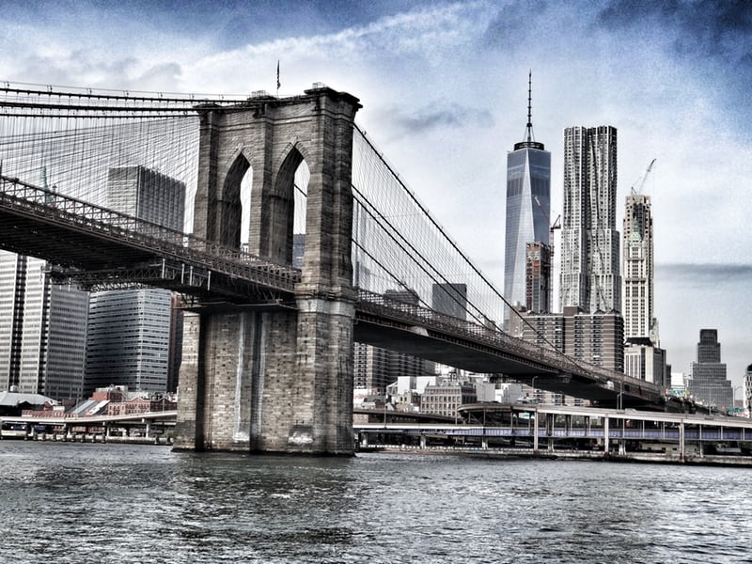

PHOTOS
Photos courtesy of unsplash.com
Brooklyn Bridge
New York City

Slide 27
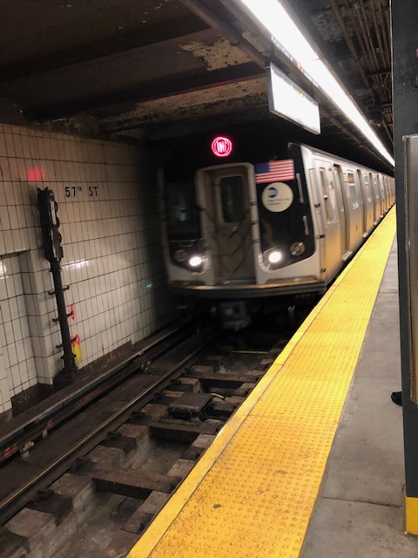
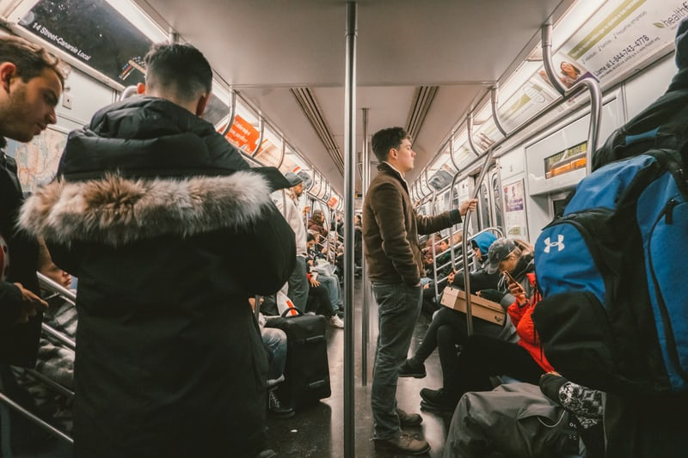
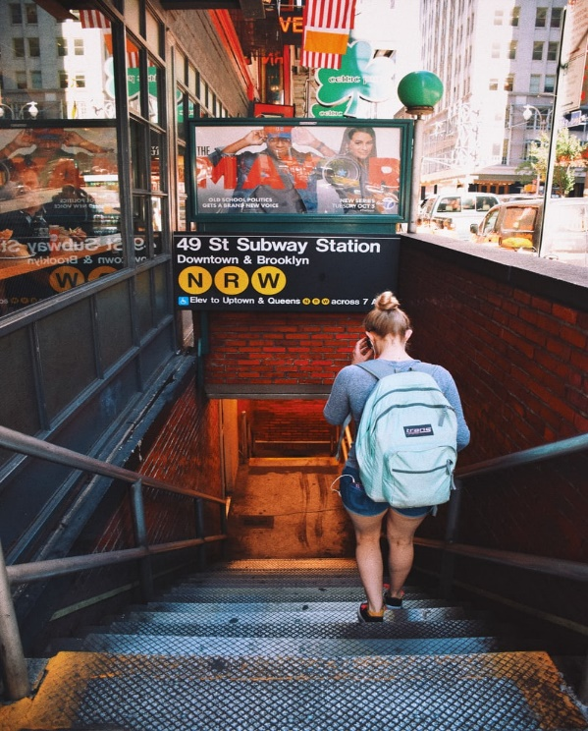
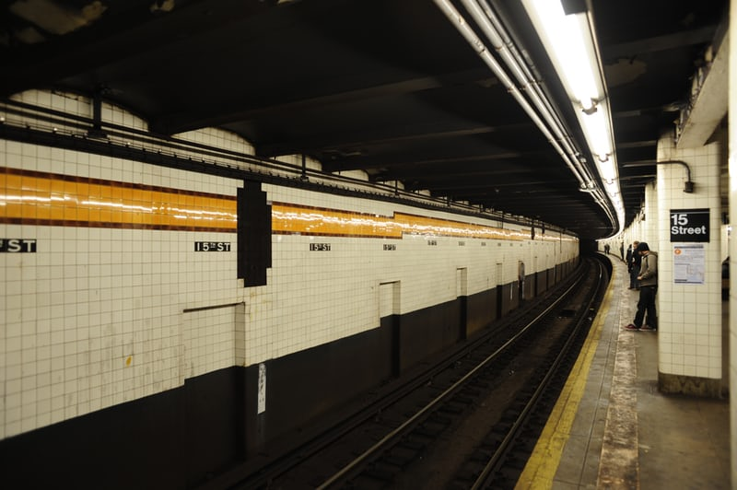
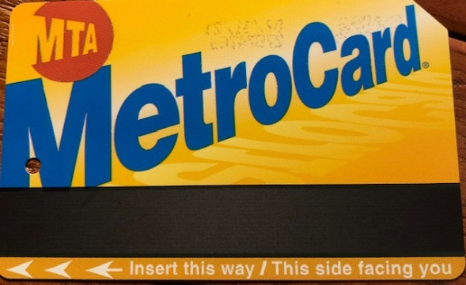
New York City subway photos
Photos courtesy of unsplash.com
Passengers
Going down
Metro Card
The train is arriving (stay behind the yellow line)
The tunnel

Slide 28
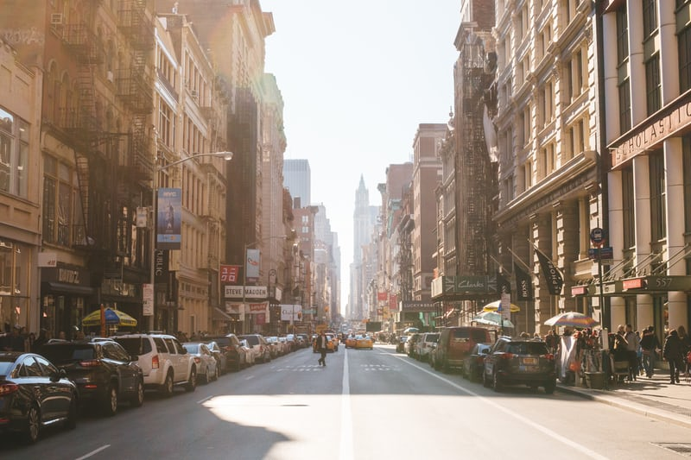

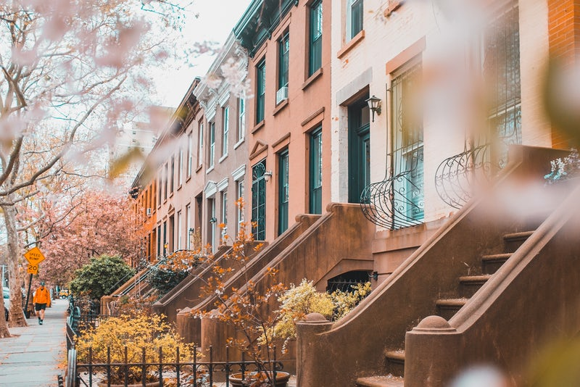
What does Brooklyn look like?
Typical NYC restaurant (like Filettos)
Brownstone row houses (similar to where Abrielle, Leon, Gina, and Mrs. Metzger live)
Photos courtesy of unsplash.com

Slide 29
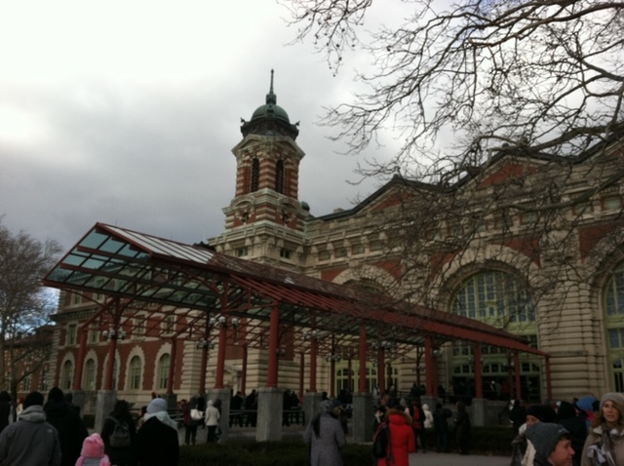
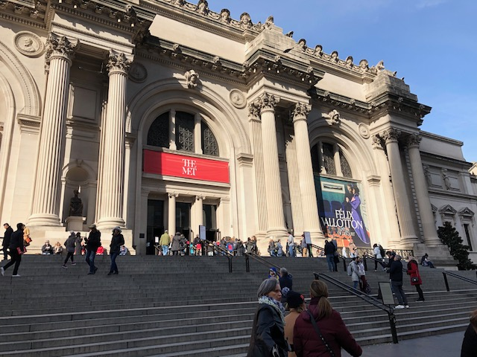
Places Abrielle visits
Metropolitan Museum of Art
Ellis
Island (now a museum)
Main Hall at Ellis Island
Photos were taken with personal camera

Slide 30

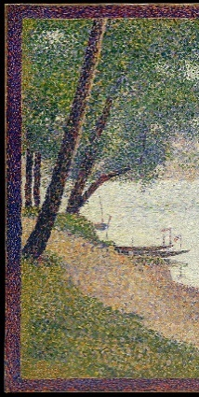
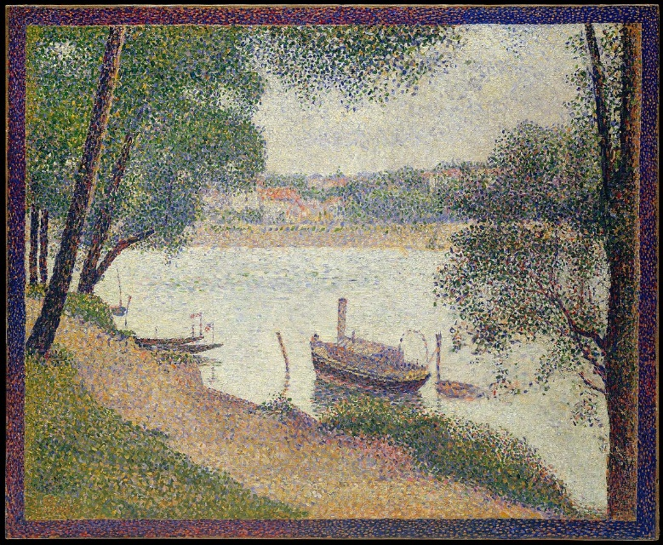
Art Work -- Not Everything is as it Seems
Gray Weather, Grande Jatte by Georges Seurat
Bridge over a Pond of Water Lilies by Claude Monet
Pictures provided by Creative Commons

Slide 31
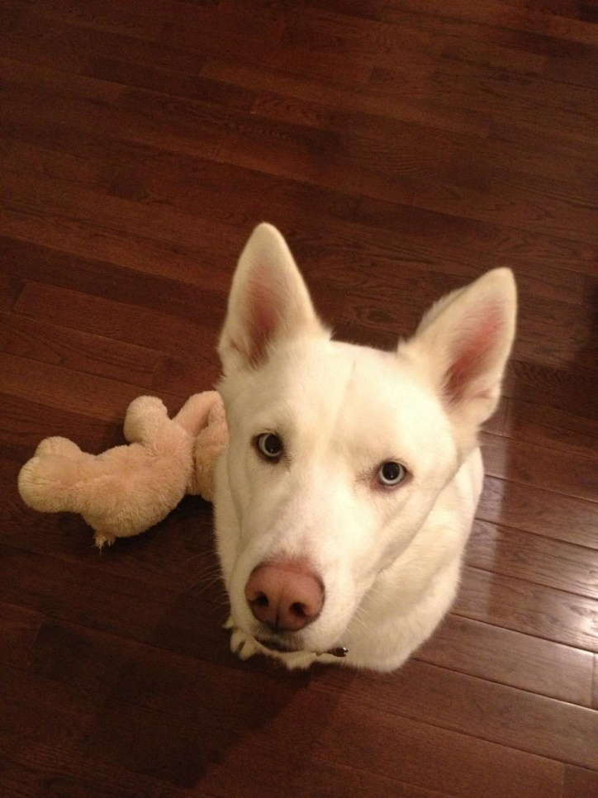
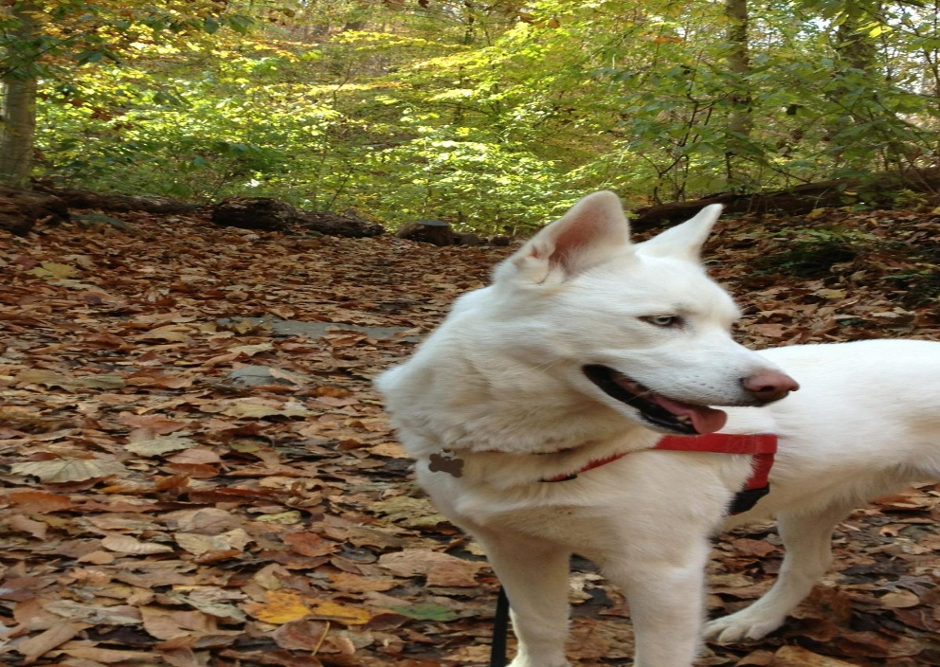
The character Chloe is based on a real dog.
Chloe lived in Brooklyn, NY with her owners Aimee and Alex. They have given permission to include Chloe in the story The Three Sleuths of Brooklyn.
Chloe was loved by everyone who met her.

Slide 32
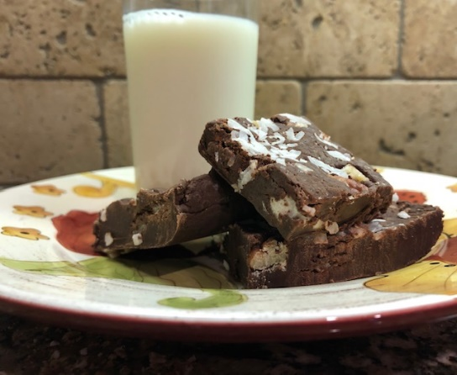

Check out the back of the book for recipes made by several of the characters.
Mrs. Metzger’s German chocolate fudge
Filettos Panna Torta (cream cake)
Aunt Carmen’s Italian lasagna
- - - - - - - - - - - - - - - - - - - - - - - - - - -
HAVE FUN COOKING!

Slide 33
THANK YOU!!
Abrielle
Gina
Leon
I hope you and your students have fun reading The Three Sleuths of Brooklyn and participating in the activities created to go along with the story.
I
If you have any questions about the curriculum, please don’t hesitate to contact me at selewis.writer@gmail.com
If you still need to buy books for your class, visit www.susanelewis.com or Amazon.com
The Three Sleuths of Brooklyn
Notes:
NOTE:
To change the image on this slide, select the picture and delete it. Then click the Pictures icon in the placeholder to insert your own image.

